Slide 1
Introduction to Quantitative Financial Risk Management with R
Ted Kwartler
https://github.com/kwartler/Quantitative_Financial_Risk_Management_with_R

Slide 2









About me
Education
https://www.linkedin.com/in/edwardkwartler/
Work
Side Hustles

Slide 3
Agenda
Start | End | Item
 |  | What is the financial market? Types of investing strategies.
 |  | What is an API? API access to stock data in R
 |  | Manipulate a time series object 1_TTR.R
 |  | How to understand basic financial plots
 |  | Make basic & dynamic plots of the data 1_TTR.R
 |  | Non-Traditional Markets
3

Slide 4
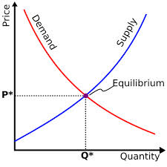
What is a Market?
Traditional Markets
Stock Markets
Bond Markets
Housing/Mortgages
Commodities – gold/silver etc
Crop Futures – corn/soybean
Consumer Credit
…
A market is one of the many varieties of systems, institutions, procedures, social relations and infrastructures whereby parties engage in exchange. Traditional markets are often regulated, have defined trading norms/rules, and have been in existence for some time.
4

Slide 5

Securities Trading can be distilled into 4 categories
Belief Based Investing
The intrinsic value of a company is appealing regardless of market & financial factors. As a result, intrinsic value changes trigger buy/sell action.
I like Wonder bread, so I bought stock in Flower Foods (FLO) since they make it.
https://www.steadygo.digital/blog/terrible-stock-photos/
5
Notes:
I like Netflix movies so I bought Netflix.
I don’t agree with tobacco sales so I avoid those stocks.
Warren Buffet “Buy companies you understand”

Slide 6

Securities Trading can be distilled into 4 categories
Financial Fundamentals Investing
Traditional financial performance indicators trigger an action regardless of sector, or company product.
Monsanto (MON) makes genetically modified food, I don’t care if they are safe. I bought the stock because the EPS is good.
6
Notes:
Reviewing an annual report and pouring over cash flow, revenue growth, expenditures like R/D all count as fundamental investing

Slide 7

Securities Trading can be distilled into 4 categories
Technical Trading
Trade based on “indications”. Uses non-financial mathematical indicators to quantify risk/reward, or trigger buy/sell
“Algorithmic Trading” – using algorithms to identify an equity action
Momentum – Recognize prices moving up/down at thresholds to trigger action
“Charting” – Visual chart patterns trigger actions (crossovers, head & shoulders)
The MACD crossover pattern for Smith & Wesson (AOBC) is positive so now is a good time to buy.
7
Notes:
Reviewing an annual report and pouring over cash flow, revenue growth, expenditures like R/D all count as fundamental investing

Slide 8
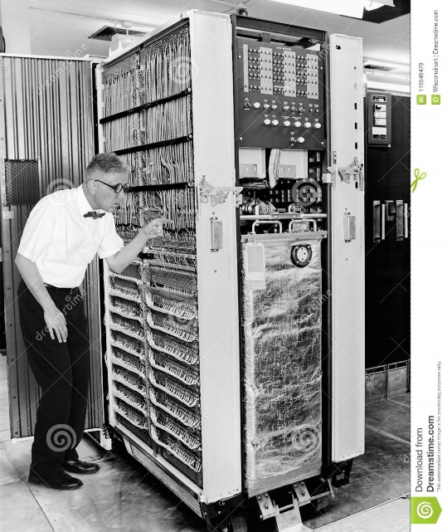

Securities Trading can be distilled into 4 categories
High Frequency Trading
Extremely technical trading executed without a human that can trigger thousands of actions measured in nano-seconds. “scalping” small profits thousands of times per minute.
1001100100…
*Although HFT uses algorithms:
>There is no human in the loop
>Primary profits derive from market making
8
Notes:
$460M

Slide 9

Speaking of Knight Cap
What happened to them?
Notes:
$460M

Slide 10
Keep in mind for trading…
In the short term the market is a NEGATIVE sum transaction. Market “makers” make money on the transactions. Retail investors pay a commission/fee for the trade.
Be careful & be sure to test your methods!
Notes:
$460M

Slide 11
What type?
The Stochastic Momentum Indicator (SMI), a formula for measuring momentum, crossed over to positive territory. I think I will buy Google (Alphabet).
Belief Based – some intrinsic value of the company is appealing and triggers a buy/selling action.
Fundamental Trading - traditional financial indicator triggers an action regardless of sector, or company product.
Technical Trading – trade based on “indications” or “algo trading”
High Frequency Trading – “scalping” small profits repeatedly
11

Slide 12
What type?
Our PhD physicist wrote an algorithm that trades apple stock 10,000 per minute.
Belief Based – some intrinsic value of the company is appealing and triggers a buy/selling action.
Fundamental Trading - traditional financial indicator triggers an action regardless of sector, or company product.
Technical Trading – trade based on “indications” or “algo trading”
High Frequency Trading – “scalping” small profits repeatedly
12

Slide 13
What type?
I won’t buy firearm companies.
Belief Based – some intrinsic value of the company is appealing and triggers a buy/selling action.
Fundamental Trading - traditional financial indicator triggers an action regardless of sector, or company product.
Technical Trading – trade based on “indications” or “algo trading”
High Frequency Trading – “scalping” small profits repeatedly
13

Slide 14
What type?
In our workshop we modeled the probability of risk using a decision tree and it looks like buying a consumer loan is a good investment.
Belief Based – some intrinsic value of the company is appealing and triggers a buy/selling action.
Fundamental Trading - traditional financial indicator triggers an action regardless of sector, or company product.
Technical Trading – trade based on “indications” or “algo trading”
High Frequency Trading – “scalping” small profits repeatedly
14

Slide 15
What type?
Google’s quarterly ad revenue is improving, so I am going to buy some shares.
Belief Based – some intrinsic value of the company is appealing and triggers a buy/selling action.
Fundamental Trading - traditional financial indicator triggers an action regardless of sector, or company product.
Technical Trading – trade based on “indications” or “algo trading”
High Frequency Trading – “scalping” small profits repeatedly
15

Slide 16
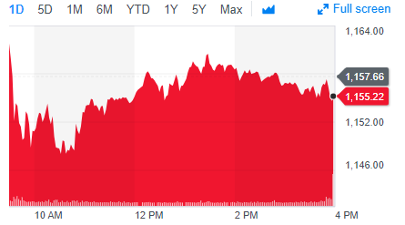
Stock Prices represent a time series
PRICE or Volume
TIME
Stock price of US Steel
16

Slide 17
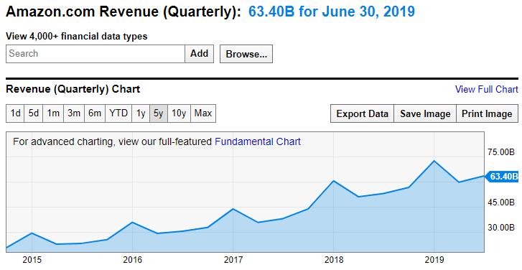
Stock Prices represent a time series
Qrtly Revenue
TIME
https://ycharts.com/companies/AMZN/revenues
This time series has a trend and seasonality so a traditional forecasting method like Holt Winters could be used.
17

Slide 18
Stock Prices represent a time series
Random Walk
VS.
Predictable Patterns (non-stock)
From a forecasting perspective stock prices are often considered a “random walk” meaning traditional econometric forecasting techniques do not apply.
18

Slide 19
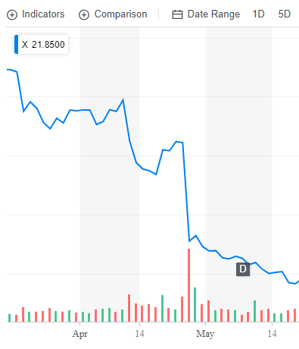
Why can’t you forecast the time series?
Daily Chart
U.S. Steel
4/25/17 Close : $31
4/26/17 Close: $22
4/26/17 Volume spike
19

Slide 20
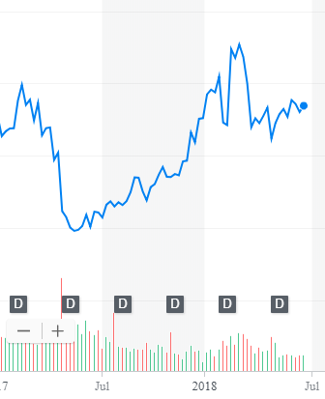
What other forces can impact US Steel?
Weekly Chart
U.S. Steel
4/25/17 Close : $31
4/26/17 Close: $22
4/26/17 Volume spike
5/15/17: ~$20
2/26/18: ~$45
Missed Qrtly Earnings
20

Slide 21
What other forces can impact US Steel?
Weekly Chart
U.S. Steel
4/25/17 Close : $31
4/26/17 Close: $22
4/26/17 Volume spike
5/15/17: ~$20
2/26/18: ~$45
4/16/18: ~$36
6/16/18: ~36
Missed Qrtly Earnings
Steel tariffs
21

Slide 22
What other forces can impact US Steel?
Weekly Chart
U.S. Steel
4/25/17 Close : $31
4/26/17 Close: $22
4/26/17 Volume spike
5/15/17: ~ $20
2/26/18: ~ $45
4/16/18: ~ $36
6/16/18: ~ $36
Missed Qrtly Earnings
Steel tariffs
Retaliatory Auto tariffs
22

Slide 23
So forecasting (pattern recognition) methods won’t work.
Weekly Chart
U.S. Steel
Some stock movements are self-inflicted (quarterly miss), others political (tariffs) while others are based on out of sector (automotive) performance.
External factors remove pattern recognition that econometric forecasts seek.
23

Slide 24
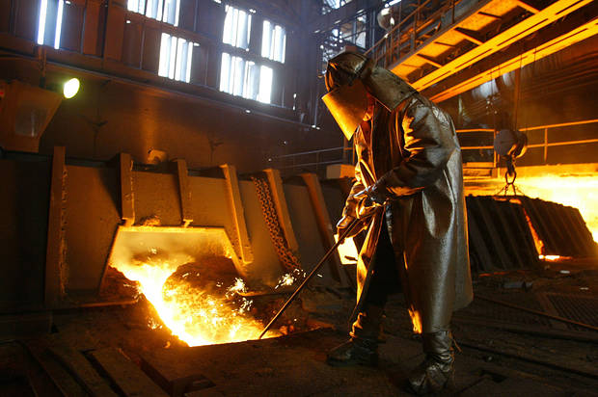
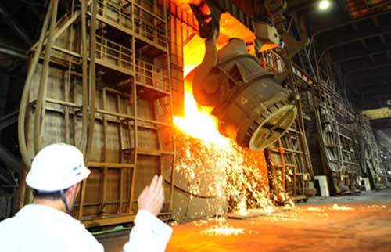

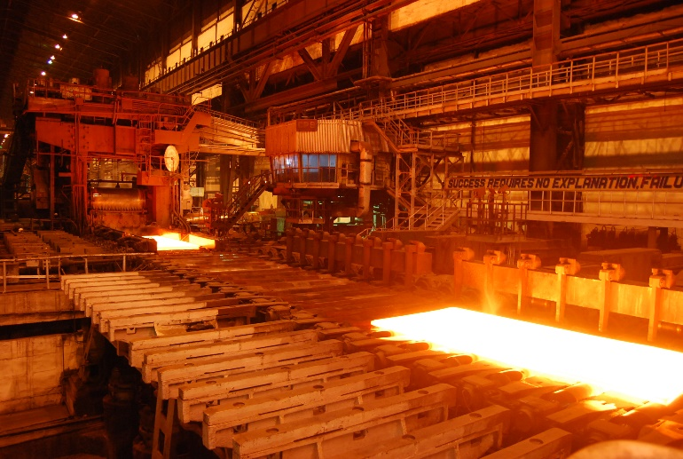
Meanwhile, US Steel was... producing steel.
A belief investor would not have bought or sold.
24

Slide 25
Meanwhile, US Steel was... producing steel.
A fundamental investor would have sold after the quarterly earnings report waiting for another financial indicator to buy again (next quarter).
25

Slide 26
Meanwhile, US Steel was... producing steel.
A technical investor may have gotten out after the price drop but back in as positive moment based on steel tariffs occurred only to sell again after the momentum faded based on automotive tariffs
26

Slide 27
Meanwhile, US Steel was... producing steel.
An HFT would have been in and out many times per second and minute making money no matter the direction, they work only with speed as an advantage.
27

Slide 28
Agenda
Start | End | Item
 |  | What is the financial market? Types of investing strategies.
 |  | What is an API? API access to stock data in R
 |  | Manipulate a time series object 1_TTR.R
 |  | How to understand basic financial plots
 |  | Make basic & dynamic plots of the data 1_TTR.R
 |  | Non-Traditional Markets
28

Slide 29

What is an API?
“Application Program Interface”
Clearly defined methods of communication between various software components.

Slide 30
Two Popular Response Formats
XML – Extensible Markup Language
Ever wonder why Excel files went from xls to xlsx? The data is stored as XML.
JSON- Javascript Object Notation
Lightweight text files used in webpage visualizations and to pass information.
Ask a question
Respond in XML or JSON

Slide 31


An example, your phone’s mapping function
“Your phone requests information from the maps API services to render the information.

Slide 32
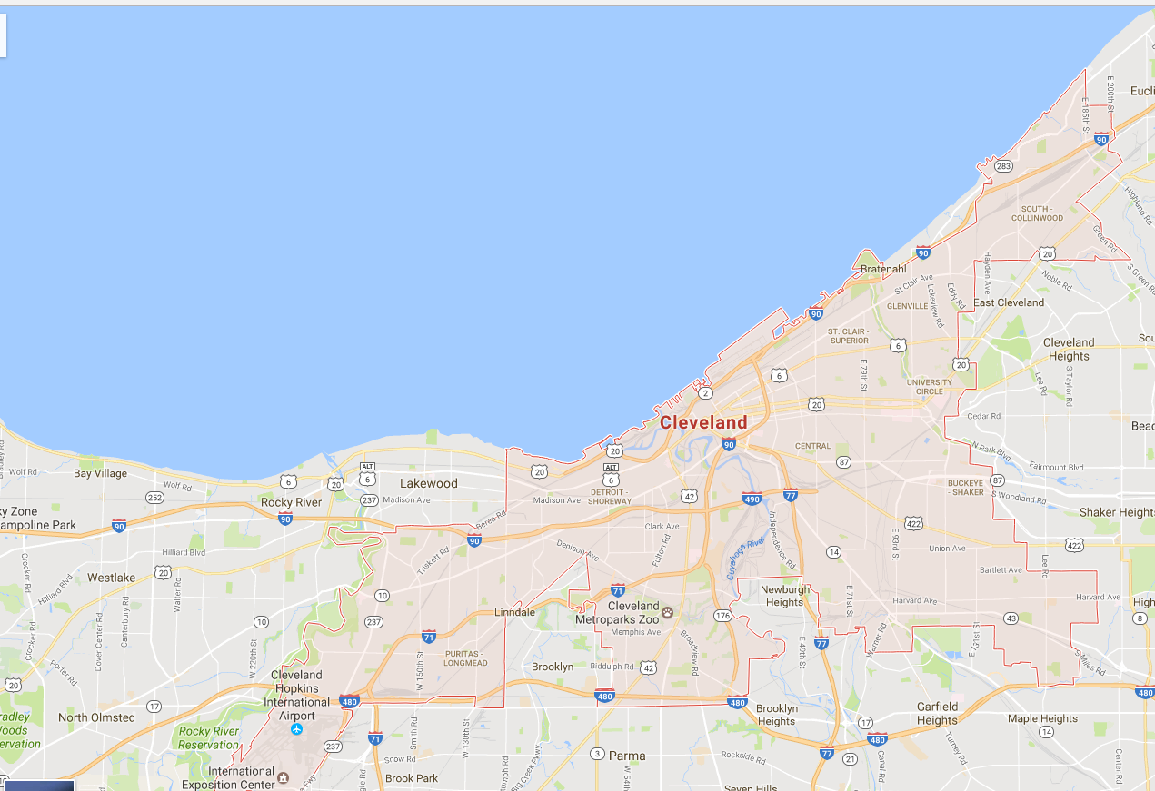
Cleveland Ohio USA Map

Slide 33
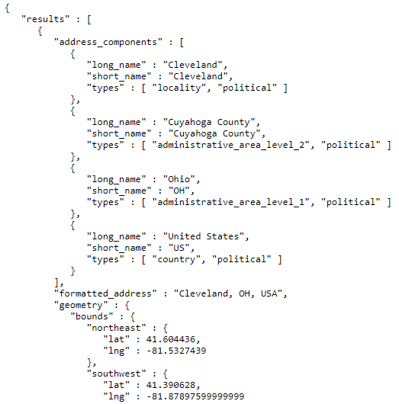
Google Maps API JSON
Cleveland name
More location information
Some coordinates of the shaded bounding box
Your phone parses JSON and renders the information on top of the map tile (shaded bounding box).

Slide 34


R has many API related libraries.
Quantmod handles the request & organizing data to a time series object.
Rather than code requests & parse responses ourselves we use the quantmod package.

Slide 35
Agenda
Start | End | Item
 |  | What is the financial market? Types of investing strategies.
 |  | What is an API? API access to stock data in R
 |  | Manipulate a time series object 1_TTR_A.R
 |  | How to understand basic financial plots
 |  | Make basic & dynamic plots of the data 1_TTR.R
 |  | Non-Traditional Markets
35

Slide 36
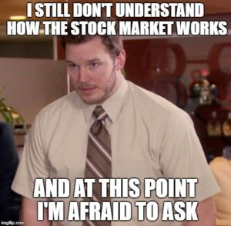
Let’s Practice! Open 1_TTR.R
Learning Objective:
Get real stock data
Subset an xts object
Plot the time series dynamically
36

Slide 37
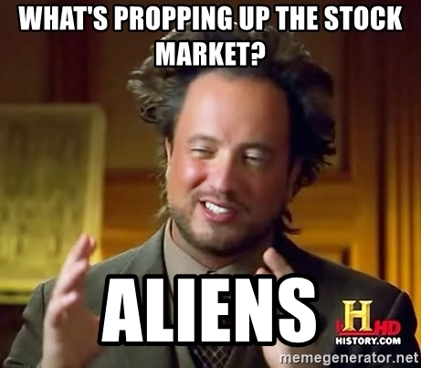
Technical Trading Assumptions
“what” > “why”
Price action > reasons for move (non-explanatory)
Technical traders don’t necessarily care why a price changes.
37

Slide 38
Technical Trading Assumptions
“what” > “why”
Price action > reasons for move (non-explanatory)
Known information is already reflected in the price.
Technical traders believe tradeable information is immediately embedded in the price (not worth the effort to “scalp” or trade based on speed).
38

Slide 39
Technical Trading Assumptions
“what” > “why”
Price action > reasons for move (non-explanatory)
Known information is already reflected in the price.
Buyers & sellers trade based on emotion.
Fear & greed are powerful forces
Technical traders realize that some amount of trades occur due to emotion. Technical traders are unemotional when trading thereby exploiting the emotional traders.
39

Slide 40
Technical Trading Assumptions
“what” > “why”
Price action > reasons for move (non-explanatory)
Known information is already reflected in the price.
Buyers & sellers trade based on emotion.
Fear & greed are powerful forces
Markets fluctuate.
For technical traders to be successful, there needs to be pricing volatility.
40

Slide 41
Let’s zoom into Technical Trading Rules (TTR)
Our learning goal is to use and understand some of the common technical indicators which affect you as a saver, pension holder, stock trader etc.
Further research is needed to be successful.
Our learning goal is NOT to make you a trader, or convince you that you are now qualified to be a technical trader.
41

Slide 42
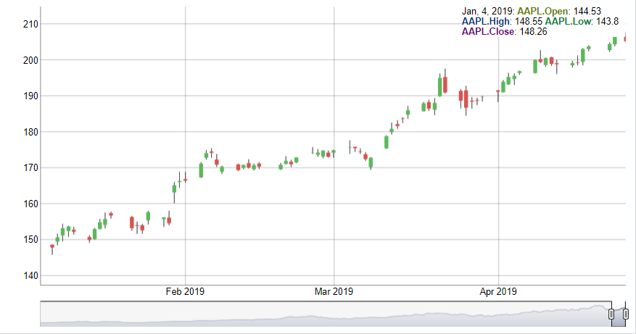
Interpreting a Candlestick Chart
Down Day
Up Day
High Price
High Price
Opening Price
Closing Price
Closing Price
Opening Price
Low Price
Low Price

Slide 43
Instead of forecasting, can we identify indicators to move in or out of positions?
library(TTR)
SMA() #simple moving average
MACD() #moving avg convergence/divergence
RSI() #Relative Strength Index
For expediency we will cover simple indicators but there are many more and you could even develop your own.

Slide 44
Agenda
Start | End | Item
 |  | Securities Summary
 |  | Securities Technical Trading Indicator- SMA
 |  | Securities Technical Trading Indicator- MACD
 |  | Securities Technical Trading Indicator- RSI
 |  | Financial Risk Modeling
 |  | Non-Traditional Markets

Slide 45
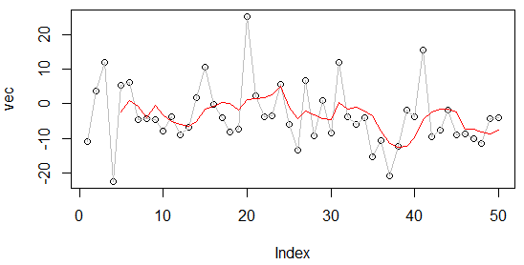
What is a moving average?
set.seed(1234)
vec <-rnorm(50,1,10)
plot(vec)
lines(vec, col='grey')
lines(SMA(vec, n=5), col='red')
A smoothing technique reducing noise in a data series. Takes the average over “n” number of periods.
45

Slide 46
What is a moving average?
set.seed(1234)
vec <-rnorm(50,1,10)
plot(vec)
lines(vec, col='grey')
lines(SMA(vec, n=5), col='red')
vec[1:15]
[1,] -11.070657
[2,] 3.774292
[3,] 11.844412
[4,] -22.456977
[5,] 5.291247
[6,] 6.060559
[7,] -4.747400
[8,] -4.466319
[9,] -4.644520
[10,] -7.900378
[11,] -3.771927
[12,] -8.983864
[13,] -6.762539
[14,] 1.644588
[15,] 10.594941
A smoothing technique reducing noise in a data series. Takes the average over “n” number of periods.
46

Slide 47
What is a moving average?
vec[1:15]
[1,] -11.070657
[2,] 3.774292
[3,] 11.844412
[4,] -22.456977
[5,] 5.291247
[6,] 6.060559
[7,] -4.747400
[8,] -4.466319
[9,] -4.644520
[10,] -7.900378
[11,] -3.771927
[12,] -8.983864
[13,] -6.762539
[14,] 1.644588
[15,] 10.594941
A smoothing technique reducing noise in a data series. Takes the average over “n” number of periods.
47

Slide 48
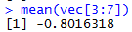
What is a moving average?
vec[1:15]
[1,] -11.070657
[2,] 3.774292
[3,] 11.844412
[4,] -22.456977
[5,] 5.291247
[6,] 6.060559
[7,] -4.747400
[8,] -4.466319
[9,] -4.644520
[10,] -7.900378
[11,] -3.771927
[12,] -8.983864
[13,] -6.762539
[14,] 1.644588
[15,] 10.594941
A smoothing technique reducing noise in a data series. Takes the average over “n” number of periods.
48

Slide 49
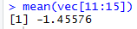
What is a moving average?
vec[1:15]
TTR::SMA(vec[1:15], n=5)
[1,] -11.070657
[2,] 3.774292
[3,] 11.844412
[4,] -22.456977
[5,] 5.291247
[6,] 6.060559
[7,] -4.747400
[8,] -4.466319
[9,] -4.644520
[10,] -7.900378
[11,] -3.771927
[12,] -8.983864
[13,] -6.762539
[14,] 1.644588
[15,] 10.594941
[1,] NA
[2,] NA
[3,] NA
[4,] NA
[5,] -2.5235367
[6,] 0.9027066
[7,] -0.8016318
[8,] -4.0637779
[9,] -0.5012865
[10,] -3.1396115
[11,] -5.1061087
[12,] -5.9534017
[13,] -6.4126457
[14,] -5.1548241
[15,] -1.4557603
A smoothing technique reducing noise in a data series. Takes the average over “n” number of periods.
49

Slide 50
What is a moving average?
A smoothing technique reducing noise in a data series. Takes the average over “n” number of periods.
vec[1:15]
TTR::SMA(vec[1:15], n=5)
[1,] -11.070657
[2,] 3.774292
[3,] 11.844412
[4,] -22.456977
[5,] 5.291247
[6,] 6.060559
[7,] -4.747400
[8,] -4.466319
[9,] -4.644520
[10,] -7.900378
[11,] -3.771927
[12,] -8.983864
[13,] -6.762539
[14,] 1.644588
[15,] 10.594941
[1,] NA
[2,] NA
[3,] NA
[4,] NA
[5,] -2.5235367
[6,] 0.9027066
[7,] -0.8016318
[8,] -4.0637779
[9,] -0.5012865
[10,] -3.1396115
[11,] -5.1061087
[12,] -5.9534017
[13,] -6.4126457
[14,] -5.1548241
[15,] -1.4557603
50

Slide 51

So how does SMA become an Indicator?
Red Card! We need to lag the trading rule to ensure the signal is realistic. Calculations are not real time, but at the day’s close so you need to adjust the results to emulate a real scenario.
51

Slide 52
Open 1_TTR.R
Learning Objective:
Get real stock data
Subset an xts object
Create three simple moving averages and plot to see the smoothing effect
52

Slide 53
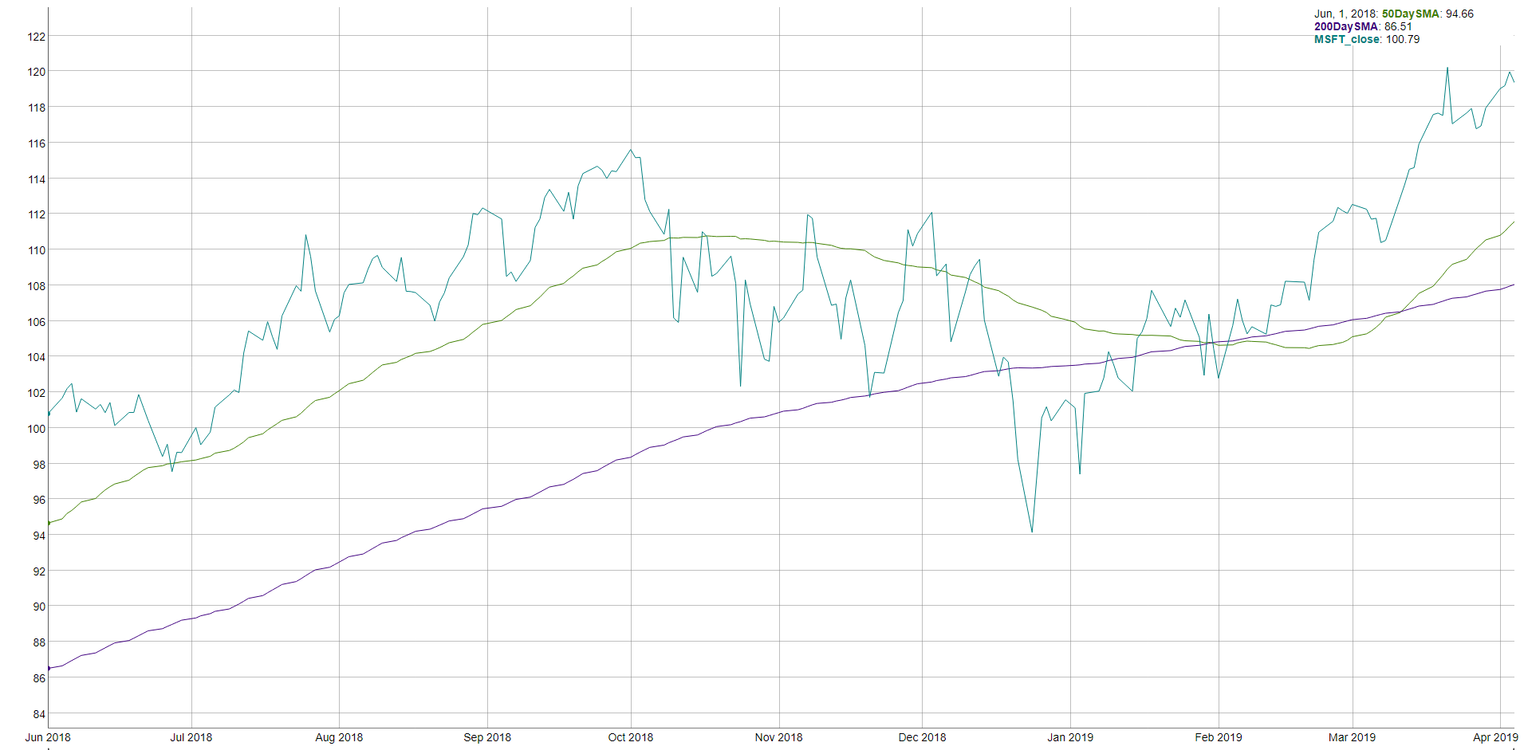
How does SMA become an indicator? MSFT 50 & 200 day SMA
“Golden Cross”
“Death Cross”

Slide 54
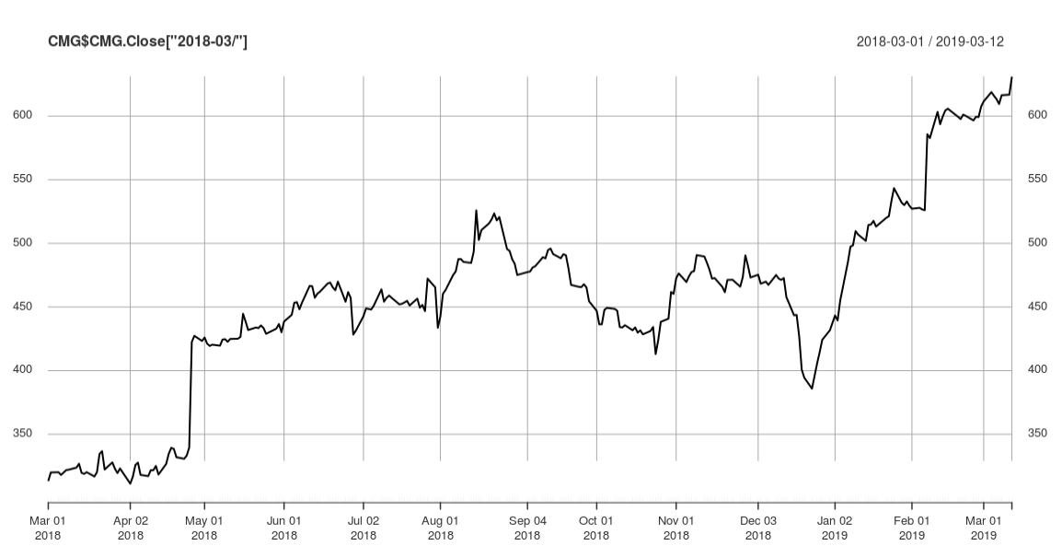
Now let’s apply death/golden cross to CMG
An investor can “backtest” the strategy to find an acceptable “n” in case 50/200 doesn’t work. Once the best “n” is found, an investor can look for “crosses” to indicate buy/sell.

Slide 55

Open 3_TTR.R
Update to CRM Salesforce stock and update script
Learning Objective:
Get real stock data
Subset an xts object
Calculate SMA 50 & 200
Create a trading indicator (rule)
Lag the Rule
Back-test the lagged rule to see cumulative returns
Switch a single character in the rule & back-test again to see the impact like Knight Capital
55

Slide 56
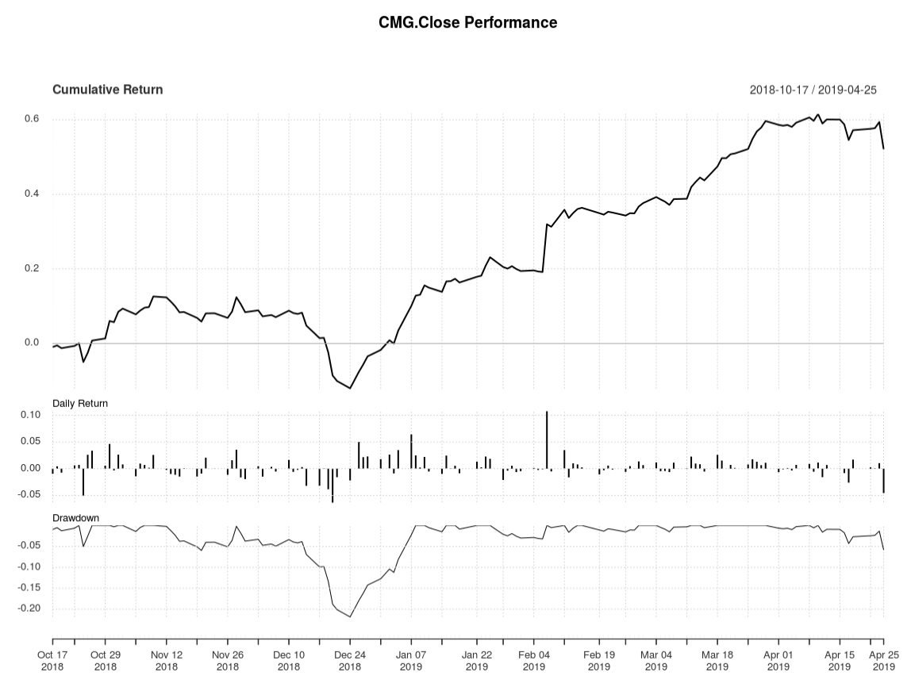
SMA as an Indicator for CMG
Total Cumulative Return using the rule.
Day to Day Return
Important if rule is sub one day periodicity.
Peak to trough % change, used to understand volatility.
Small mistakes can lead to big consequences…ask Knight Capital employees.
56

Slide 57
Agenda
Start | End | Item
 |  | Securities Summary
 |  | Securities Technical Trading Indicator- SMA
 |  | Securities Technical Trading Indicator- MACD
 |  | Securities Technical Trading Indicator- RSI
 |  | Financial Risk Modeling
 |  | Non-Traditional Markets

Slide 58

Moving Average Convergence Divergence
By measuring the moving average of two moving averages with different time frames, an investor hopes to capture when momentum is building or receding.

Slide 59
Moving Average Convergence Divergence
Instead of SMA’s “n”:
nFast(12) – the smaller window to measure (12 periods)
nSlow(26)- the longer window to measure (26 periods)
nSig(9)- the number of periods used to measure the avg difference “signal”
Calculate the 12 (nFast) day & 26 (nSlow) day moving averages.
Calculate the difference between averages from #1
Calculate the 9 day Moving Avg (nSig) of #2
When MACD > Signal, the price is accelerating, positive momentum/money is coming to the equity which represents a buying opportunity. Converse is true.
59

Slide 60
One small addition difference.
SMA
EMA
Each value in the “n” window has an different weight. The weights decrease the farther back in time e.g. recent data is more relevant.
Each value in the “n” window has an equal weight.
Usually the MACD uses the Exponential Moving Average (EMA) not Simple Moving Average
60
Notes:
Advantage:
Faster to recognize a buy/sell signal.
Disadvantage:
More false signals, more sensitivity

Slide 61
SMA Vs EMA
vec <- c( 1.2, 0.2, 10, 20.3, 104.3)
Recheck and possibly change into multiple slides
Each value has equal weight in the window.
Recent values have MORE weight in the window.
TTR::SMA(vec, n=3)
TTR::EMA(vec, n=3)
= 44.86
= 58.175
 | Value | SMA-3 | EMA-3 | Formula
Time1 | 1.2
Time2 | 0.2
Time3 | 10 | 3.8 | 3.80
Time4 | 20.3 | 10.2 | 12.05 | 20.3 * 2/(3+1) + 3.80 * (1-2/(3+1))
Time5 | 104.3 | 44.867 | 58.175 | 104.3*2/(3+1)+12.05*(1-2/(3+1))

Slide 62
Open 4_TTR.R
Learning Objective:
Get real stock data
Subset an xts object
Calculate MACD
Plot a dynamic graph of the closing & MACD indicator
Visually inspect the results of buy/sell actions
Calculate cumulative return for the indicator
62

Slide 63
Agenda
Start | End | Item
 |  | Securities Summary
 |  | Securities Technical Trading Indicator- SMA
 |  | Securities Technical Trading Indicator- MACD
 |  | Securities Technical Trading Indicator- RSI
 |  | Financial Risk Modeling
 |  | Non-Traditional Markets

Slide 64
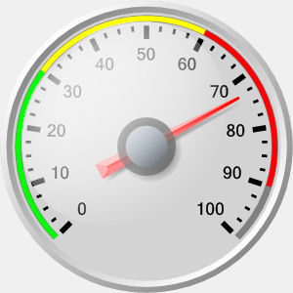
Relative Strength Index (RSI)
Momentum Oscillator
Index between 0-100
Compares average gains and losses in 14 day periods (“n”)
Usually interpreted as an overbought/oversold (over 70 / below 30)
* Usually uses EMA but we will do SMA.
64

Slide 65
Creates a control chart.
overbought
70
RSI
30
Buy/sell
oversold
TIME
When the RSI dips below a threshold (30) the stock is considered “oversold” meaning the market has overreacted indicating a buying opportunity. RSI greater than 70 indicates the market is over buying the stock so it may be good to exit your position.
65

Slide 66
Calculating the RSI
RSI = 100 - (100 / 1+RS)
Where RS:
RS = Avg Gain / Avg Loss
Avg Gain = For “up” days, total number of points up / number of “up” days (14 trading days)
Avg Loss = For “down” days, total number of points down/ number of “down” days (14 trading days)
66

Slide 67
Open 5_TTR.R
Learning Objective:
Get real stock data
Calculate RSI
Plot a dynamic graph of the closing & RSI indicator
Visually inspect the results of buy/sell actions
Calculate cumulative return for RSI and MACD together
67

Slide 68
Agenda
Start | End | Item
 |  | Securities Summary
 |  | Securities Technical Trading Indicator- SMA
 |  | Securities Technical Trading Indicator- MACD
 |  | Securities Technical Trading Indicator- RSI
 |  | Financial Risk Modeling
 |  | Non-Traditional Markets

Slide 69

Consumer Credit - Lending Club
Consumers apply for loans & instead of bank funding, other consumers fund the loan by purchasing “notes” to receive the interest.
Peer to Peer funding for
Personal Loans
Auto Loans
Small Business Loans
Medical Loans
Everyday investors can accept the loan risk – making it a new banking distribution model
Consumer credit is a traditional market. There are defined inputs (credit score), consumer protections (usury laws), and established distribution (credit applications).
69

Slide 70
What’s the Risk?
Risk
Mitigation
Over exposure in a single loan
Diversify – Do not fund more than $25 on a single loan
Early payment reduces interest received
Monitor & re-invest monthly
Illiquid – notes are 36-60 months
Buy notes with 36m horizons
Default – debtors that stop paying
Model the probability of default
70

Slide 71
What’s the Reward?
Reward
Result
Interest is imposed by LC
Investors have no input to the amount
Usually lower rates for the applicant
Lower capital cost for debtor
LC takes 1% of interest
Reduces reward incentive for investor
Remaining interest is paid monthly to note holders.
Investors act as banks & receive consistent returns
71

Slide 72

Example
Erin decides to buy a car. Instead of a traditional loan she applies at LC.
Erin applies for a $10k car loan
LC assesses her creditworthiness & posts a $10k loan @ 6% interest on the investor site.
Trish & hundreds of other LC investors fund the loan in $25 increments called “notes”
Each month Erin pays her loan, LC takes 1% and the investors make 5% on their outstanding notes.
72

Slide 73
Example
11 yrs of historical performance – Over 1M notes publicly available
Some platform changes in that time
Datasets are updated monthly
Sampled to 20k – either in fully paid of charged off state
Loan Origination
36 or 60 Monthly Payments
Fully Paid
1 = Success Class
Transitional States of Nature:
Grace Period, 30-60,60-90 days
0 = Failure Class
Charged Off
https://www.lendingclub.com/info/download-data.action
73

Slide 74
What is cross – validation?
This is a typical partitioning schema to avoid overfitting.
Training Data
All Data
Test Data
74
Notes:
No Cross Validation
No Feature Engineering

Slide 75
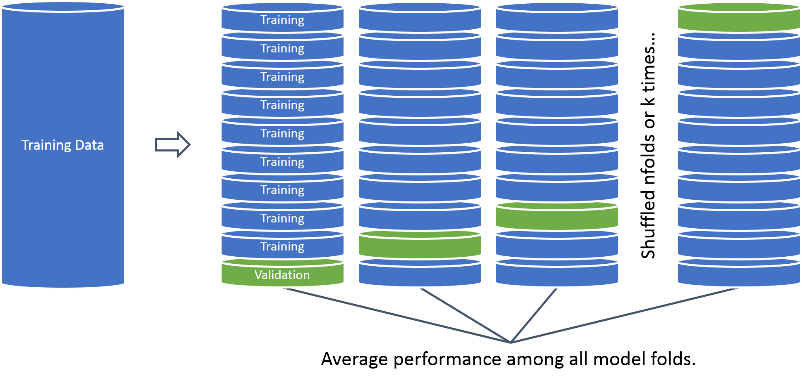
What is cross – validation?
In this example we will perform cross validation because the data set is 20k records.
75

Slide 76
Open 6_CreditModeling.R
Learning Objective:
Load in real lending club data
Treat the variables for modeling
Build a cross validated logistic regression with caret
Save model object & variable treatment plan
76

Slide 77
Cutoff Threshold
Is 0.50 the optimal cutoff?
Should we be equal weighted?
Do we care equally about picking paying notes and charged off loans?
77

Slide 78
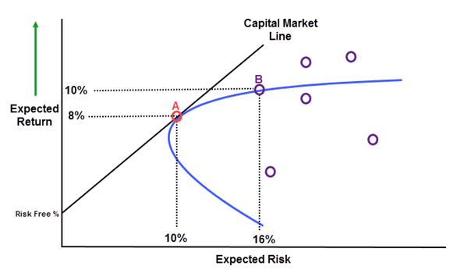
Open 7_CreditModeling.R
Learning Objective:
Score notes
Make a plot similar to CAPM & identify top loans to fund
78

Slide 79
Agenda
Start | End | Item
 |  | Securities Summary
 |  | Securities Technical Trading Indicator- SMA
 |  | Securities Technical Trading Indicator- MACD
 |  | Securities Technical Trading Indicator- RSI
 |  | Financial Risk Modeling
 |  | Non-Traditional Markets

Slide 80
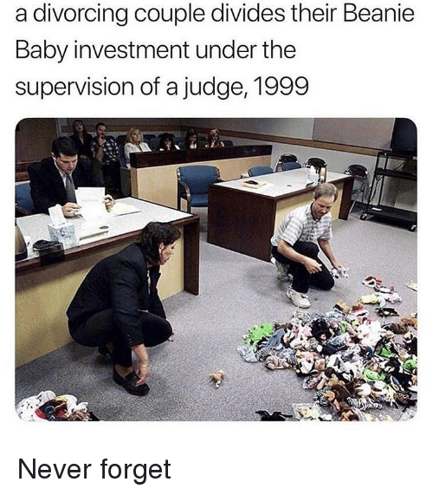
Non-Traditional Markets
Traditional
Non-Traditional
Stock Markets
Bond Markets
Housing/Mortgages
Commodities – Gold, Silver etc.
Crop Futures
Consumer Credit
Crypto-currencies
Beanie Babies
Derivatives (originally)
Web Domains
…
In contrast to traditional markets, emerging or non traditional markets lack transparency, regulations and can often be manipulated more easily.
80

Slide 81
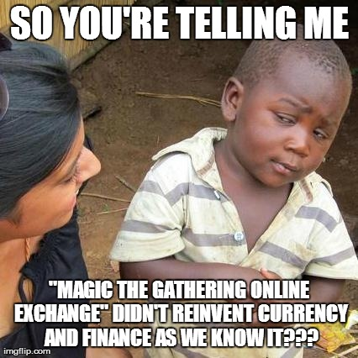

A non-traditional Market - Example
Owned by Hasbro, MTG is a 25 year old collectible trading card game. It is estimated that there are 8-12million players worldwide. Thus is it popular and has demonstrated longevity unlike other non-traditional markets.
81

Slide 82
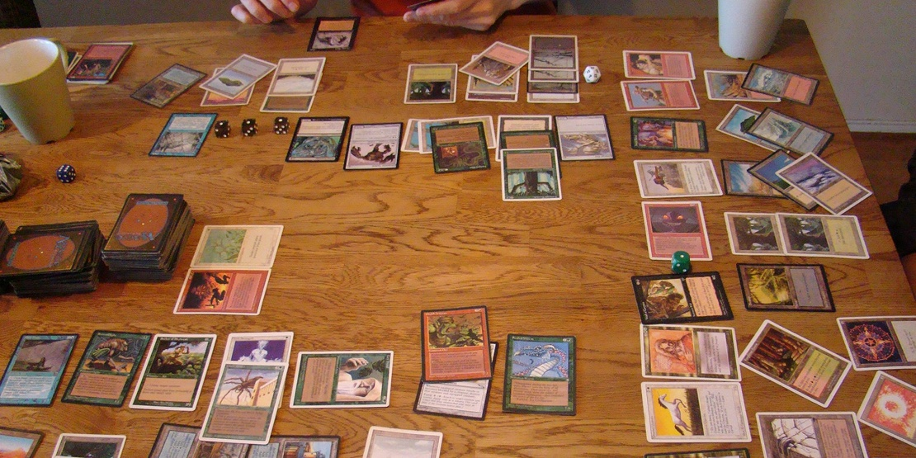
Magic The Gathering
Players create 60 card decks with cards of different abilities for a duel. Cards are fantasy based with creatures, sorceries, and mythical artifacts.
82

Slide 83
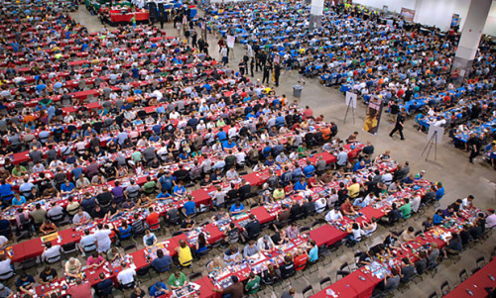

Magic The Gathering
The cards have limited print runs & varying rarities
83

Slide 84
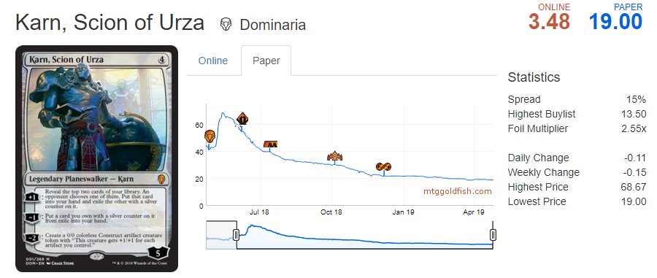
And that’s why it’s a market…
Once popular the card was $50 now $19 at sites like as mtggoldfish.com and mtgstocks.com
84

Slide 85
So how do you get cards?
For $19
You could buy Karn from an online marketplace.
For $3
You can open a booster pack from the appropriate expansion set and hope you get it.
For $90
You can buy a booster box of 36 packs from the set and increase your odds of getting it while also getting many other potential valuable cards.
For $540
You can buy 6 of the booster boxes in a case.
Say you are a player that needs to get Karn, Scion of Urza to complete a deck.
85

Slide 86
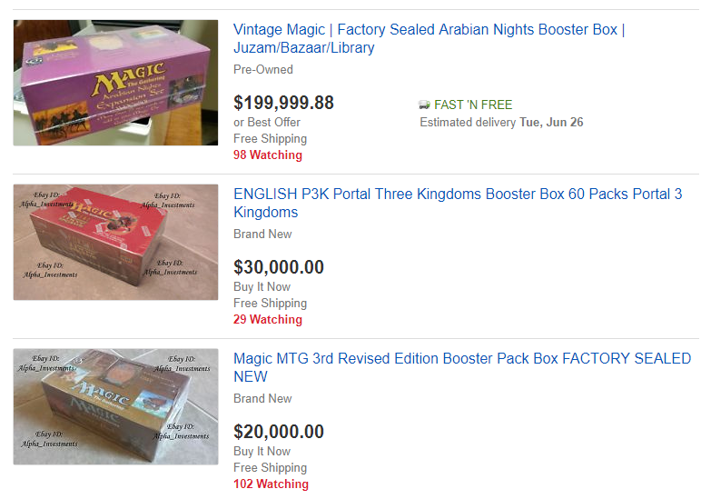
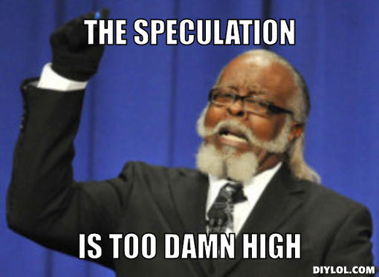
People Speculate as Supply Diminishes
86

Slide 87
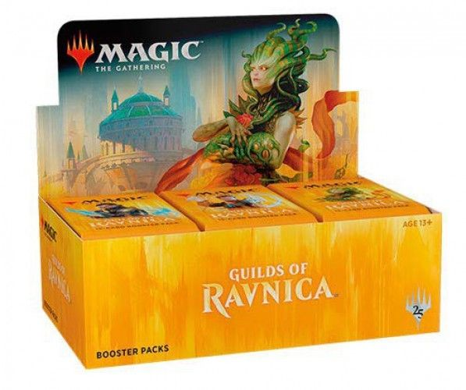
New set characteristics
Usually a pack contains
11 Commons
3 Uncommons
1 Rare
1 in 8 packs will replace the rare with a mythic
1 in 6 packs will have a random premium foil card replacing a common.
87

Slide 88
Modeling a new set according to risk & reward
When you open a pack:
Risk:
Each expansion set has varying prices. Some cards are worthless while other cards can be expensive..
Reward:
Some packs will contain expensive cards which you can immediately sell for more than the cost of the pack.
Since we know the cards in a set, their prices, and the probabilities of getting specific cards, we can simulate pack openings.
*Keep in mind there are friction costs, shipping a physical good takes time and money.
88

Slide 89

Open 3_SimulateBoosters.R
Learning Objective:
Simulate opening to analyze a non-traditional market
89

